Slide 1

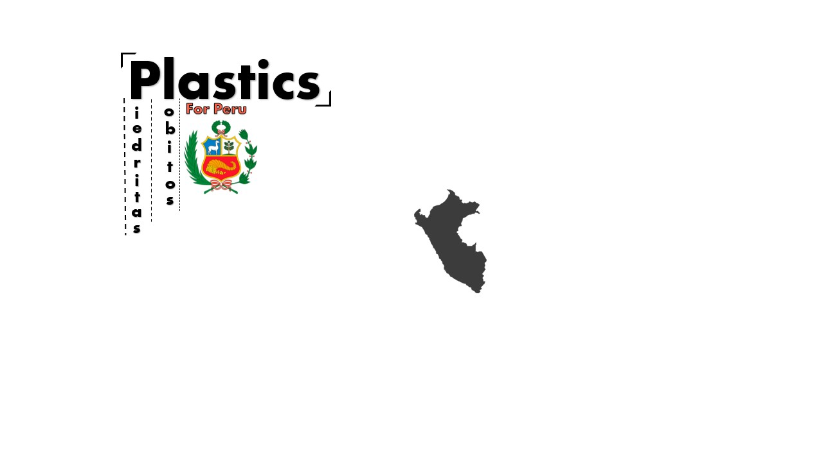


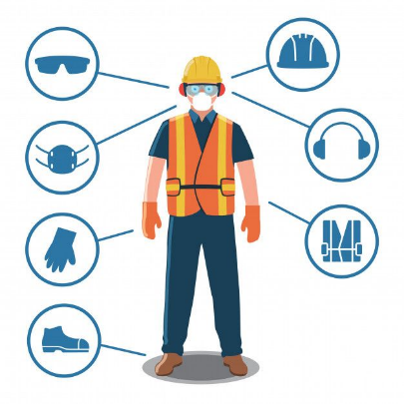








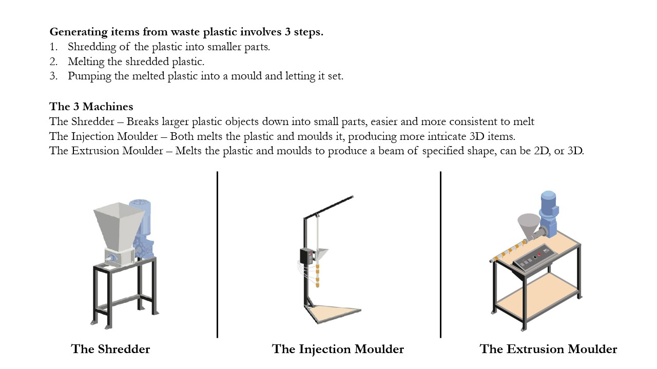
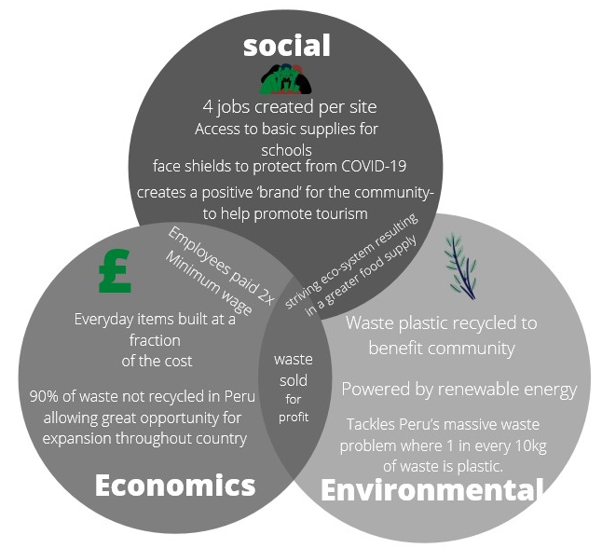
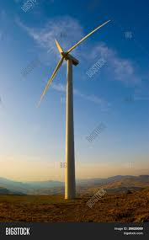
Cost
Risk and Safety
Distanced
Entanglement
Maintenance
Sharp objects
Toxic fumes
Costs | GBP | Sol
Solar Panels | £19,810.97 | S/ 94,893.24
Fencing | £5,744.15 | S/ 19,088.88
Salaries | £4,902.24 | S/ 23,106.32
Machines | £4,382.69 | S/ 20,657.46
Molds (stage 1 - 3) | £3,773.69 | S/ 17,989.99
Collection Points | £1,439.65 | S/ 6,863.12
Total | £40,053.39 | S/ 182,599.01
Waste is collected from three key areas:
The town
The local dumpsite
The sea
The plastic can also be Imported from other areas of Peru if the supply was too low from the local area.
It is then taken to a local collection point. Here, the plastics are inspected and sorted into the various plastic types. A mobile collection bike can also be used to take the plastic to the recycling centre.
About us
Strengths
Weaknesses
Reduces plastic pollution
High initial cost
Creates useful items out of waste
Design must be outside for ventilation
Reduces amount of waste being improperly disposed of
Somewhat Relies on tourism restarting
The recycled plastics will be used to make various items, such as face masks, key chains, and rules. Some items will benefit the locals in the area, other items will be sold to tourists to generate an income. Any additional income after expenses is then put back into the local area to help Lobitos.
Improves overall quality of life
At the factory, the plastics that are received from the collection point and gathered from the bike are processed into a form where they can be reused. The plastic is shredded down into small flakes and sorted into different boxes depending on the flake sizes. The flakes are then used to create various items. These can be created by using either an injection machine, which injects melted plastics into a mould to create small objects, or by using an extrusion machine, which creates a line of plastic which can be spun into new items.
Opportunities
Threats
Large amounts of waste plastic already congregated
High chance of theft
90% of waste in Peru is not recycled of which every 1 in 10 kg of this is plastic, allowing massive room for expansion
May not receive all projected funding
Relies on a community effort
Energy
Solution
Wind Turbines
Properties
Power = 20-100kW
Rotor
Diameter = 20m
Swept Area = 314m²
Material: Glass-fibre reinforced plastic
Tower
Height = 24m
Shape = Conical

Slide 2
Strengths
Weaknesses
Reduces plastic pollution
High initial cost
Creates useful items out of waste
Design must be outside for ventilation
Reduces amount of waste being improperly disposed of
Largely reliable on the return of tourists
Improves overall quality of life
Opportunities
Threats
Large amounts of waste plastic already congregated
High chance of theft
90% of waste in Peru is not recycled of which every 1 in 10 kg of this is plastic, allowing massive room for expansion
May not receive all projected funding
Dependent on a community effort

Slide 3
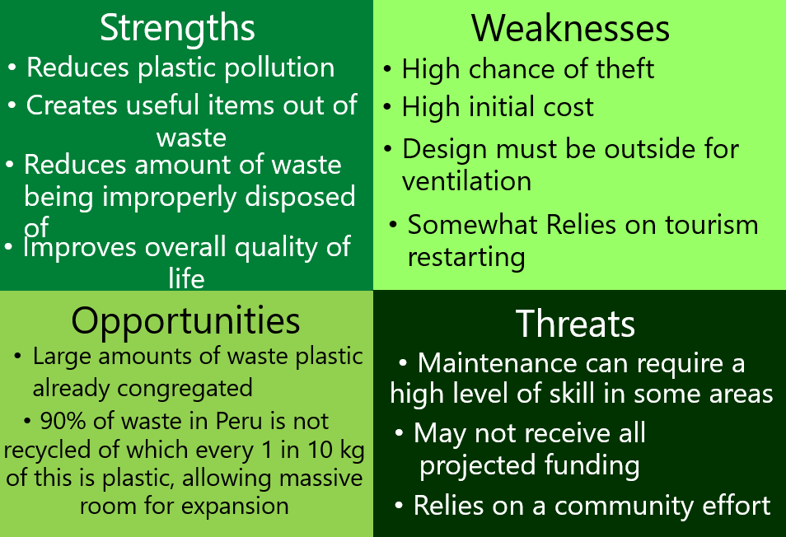
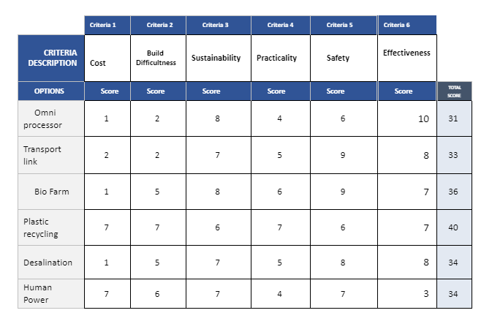



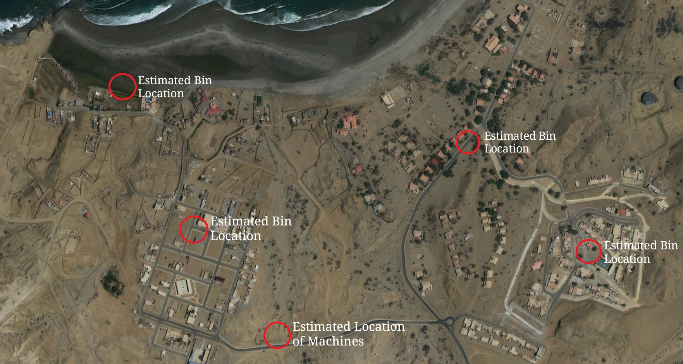

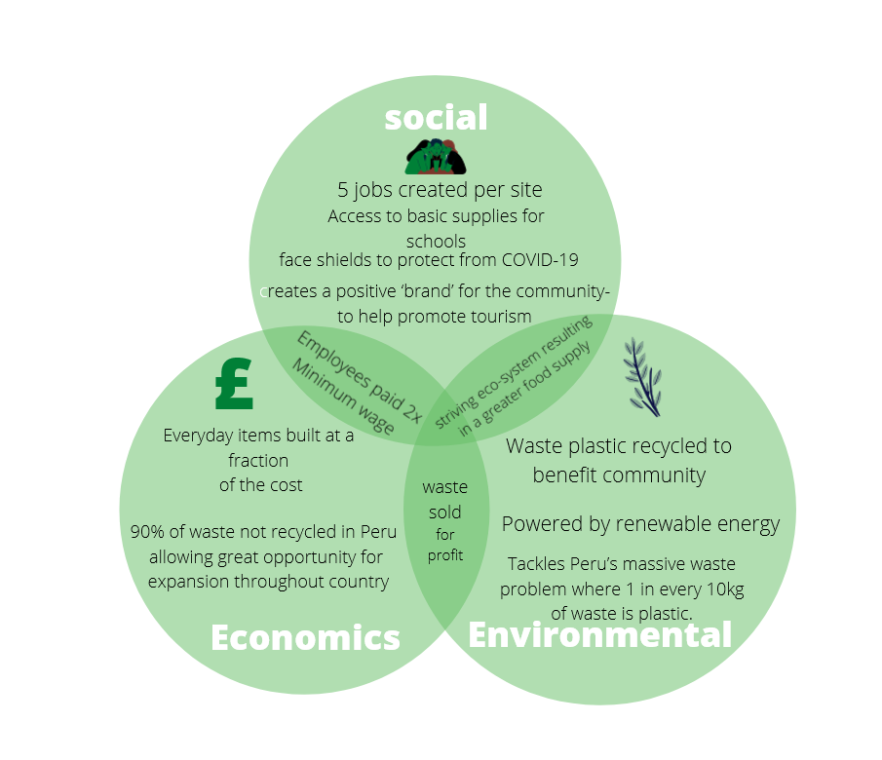

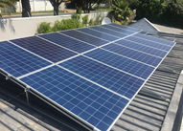
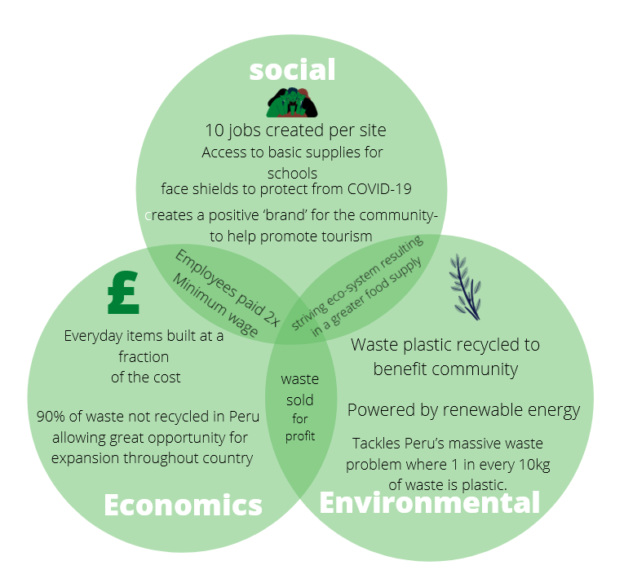
Stage 0
- Source Funding for the project
Assemble and ship the required goods
Acquire and develop the facility
Begin training scheme for unemployed locals
Stage 1
Place Recycling collection points & Collect all available recycled plastics
Begin production on Face shields & Classroom supplies
Distribute items amongst Lobitos & Piedritas
Measure Success of this stage, can we progress?
Stage 2
Obtain and assemble a plastic extrusion machine
Diversify our production, making water bottles, keyrings and recycling bins.
Sell keyrings to tourists, recycling all money earned back into production.
Stage 3, 4 and 5
Through measuring the success of the previous stage, upscale production in order to make both, more, and larger items.
Increase the amount of machinery and solar panels in order to sustain a healthy manufacturing process.
About us
SWOT Analysis
Design Matrix
Despite good amounts of tourism in the area the communities of Lobitos and Piedritas struggle from high levels of poverty. This is partly because much of the money generated from this tourism goes to foreign investors instead.
In order to improve the quality of life of people in the region we plan to recycle their plastic waste, into several solutions which can be used to help the community and several items which can be sold to tourists, generating capital which can be reinvested in our project and allowing the local community to benefit more from the tourism industry.
As plastic is so versatile it can be used to address a range of issues the communities face, from rainwater collection to school supplies. Our project also allows new solutions to be created as new issues come up.
The Process
Waste is collected from three key areas:
The town
The local dumpsite
The sea
The plastic can also be Imported from other areas of Peru if the supply was too low from the local area.
It is then taken to a local collection point. Here, the plastics are inspected and sorted into the various plastic types. A mobile collection bike can also be used to take the plastic to the recycling centre.
The recycled plastics will be used to make various items, such as face masks, key chains, and rules. Some items will benefit the locals in the area, other items will be sold to tourists to generate an income. Any additional income after expenses is then put back into the local area to help Lobitos.
At the factory, the plastics that are received from the collection point and gathered from the bike are processed into a form where they can be reused. The plastic is shredded down into small flakes and sorted into different boxes depending on the flake sizes. The flakes are then used to create various items. These can be created by using either an injection machine, which injects melted plastics into a mould to create small objects, or by using an extrusion machine, which creates a line of plastic which can be spun into new items.
Energy
Costs
A 25kV Hybrid Solar System was chosen as our power source.
Peru has consistent high-intensity sun that provides a valuable source of energy. Solar energy in sunlight is converted into electrical energy through photovoltaic cells found in the solar panels. This is connected to main power grid to allow the electricity to be distributed amongst the machines. Furthermore, a hybrid solar system additionally has a battery back-up system for excess power to be still charged into the load. This enables the energy to still run, even when a grid is not available.
Costs | GBP | Sol
Solar Panels | £19,810.97 | S/ 94,893.24
Fencing | £5,744.15 | S/ 19,088.88
Salaries | £4,902.24 | S/ 23,106.32
Machines | £4,382.69 | S/ 20,657.46
Molds (stage 1 - 3) | £3,773.69 | S/ 17,989.99
Collection Points | £1,439.65 | S/ 6,863.12
Total | £40,053.39 | S/ 182,599.01
Machines
Risk and Safety
Distanced
Entanglement
Maintenance
Sharp objects
Toxic fumes

Slide 4

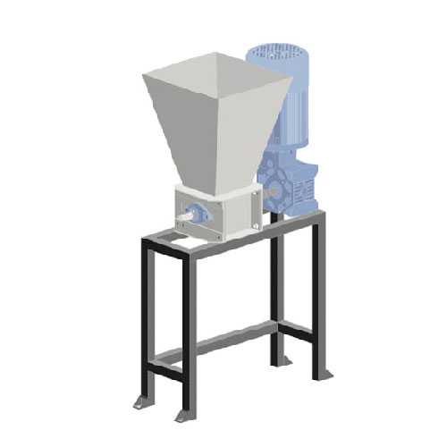
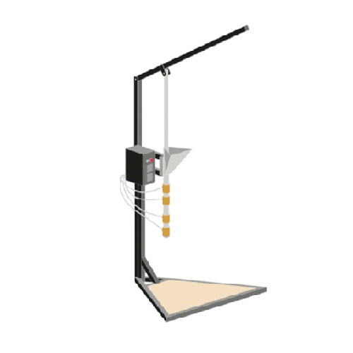
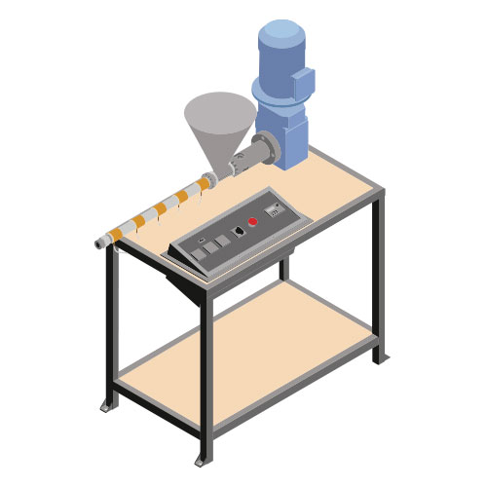
6. Stages
Stage 0
- Source Funding for the project
Assemble and ship the required goods
Acquire and develop the facility
Begin training scheme for unemployed locals
Stage 1
Place Recycling collection points & Collect all available recycled plastics
Begin production on Face shields & Classroom supplies
Distribute items amongst Lobitos & Piedritas
Measure Success of this stage, can we progress?
Stage 2
Obtain and assemble a plastic extrusion machine
Diversify our production, making water bottles, keyrings and recycling bins.
Sell keyrings to tourists, recycling all money earned back into production.
Stage 3, 4 and 5
Through measuring the success of the previous stage, upscale production in order to make both, more, and larger items.
Increase the amount of machinery and solar panels in order to sustain a healthy manufacturing process.
1. About us
2. Design Matrix
3. SWOT Analysis
4. Social Implications
5. Risk and Safety
Despite good amounts of tourism in the area the communities of Lobitos and Piedritas struggle from high levels of poverty. This is partly because much of the money generated from this tourism goes to foreign investors instead.
In order to improve the quality of life of people in the region we plan to recycle their plastic waste, into several solutions which can be used to help the community and several items which can be sold to tourists, generating capital which can be reinvested in our project and allowing the local community to benefit more from the tourism industry.
As plastic is so versatile it can be used to address a range of issues the communities face, from rainwater collection to school supplies. Our project also allows new solutions to be created as new issues come up.
7. The Process
8. Machines
Distanced
Entanglement
Maintenance
Sharp objects
Toxic fumes
Waste is collected from three key areas:
The town
The local dumpsite
The sea
The plastic can also be Imported from other areas of Peru if the supply was too low from the local area.
It is then taken to a local collection point.
Here, the plastics are inspected and sorted into the various plastic types.
A mobile collection van can also be used to take the plastic to the recycling centre.
Generating items from waste plastic involves 3 steps.
Shredding of the plastic into smaller parts.
Melting the shredded plastic.
Pumping the melted plastic into a mould and letting it set.
11. Economics
The Shredder
The 3 Machines
The Shredder – Breaks larger plastic objects down into small parts, easier and more consistent to melt
The Injection Moulder – Both melts the plastic and moulds it, producing more intricate 3D items.
The Extrusion Moulder – Melts the plastic and moulds to produce a beam of specified shape, can be 2D, or 3D.
The Injection Moulder
The plastics are then received from the collection point.
They are processed into a form where they can be reused.
The plastic is shredded down into small flakes and sorted into different boxes depending on the flake sizes and plastic types. The flakes are then used to create various items as explained in section 8.
The recycled plastics will be used to make various items, such as:
face masks
key chains
rulers
The Extrusion Moulder
Costs | GBP | Sol
Solar Panels | £19,810.97 | S/ 94,893.24
Fencing | £5,744.15 | S/ 19,088.88
Salaries | £4,902.24 | S/ 23,106.32
Machines | £4,382.69 | S/ 20,657.46
Molds (stage 1 - 3) | £3,773.69 | S/ 17,989.99
Collection Points | £1,439.65 | S/ 6,863.12
Total | £40,053.39 | S/ 182,599.01
10. Energy
9. Locations
A 25kV Hybrid Solar System was chosen based one energy requirements
Peru receives consistent high-intensity sun that provides a valuable source of energy
Hybrid solar system to ensure a constant supply of energy

Slide 5

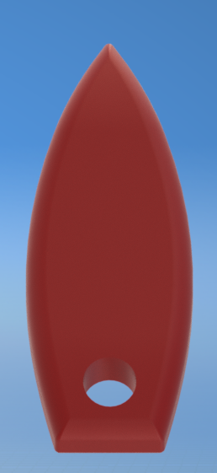
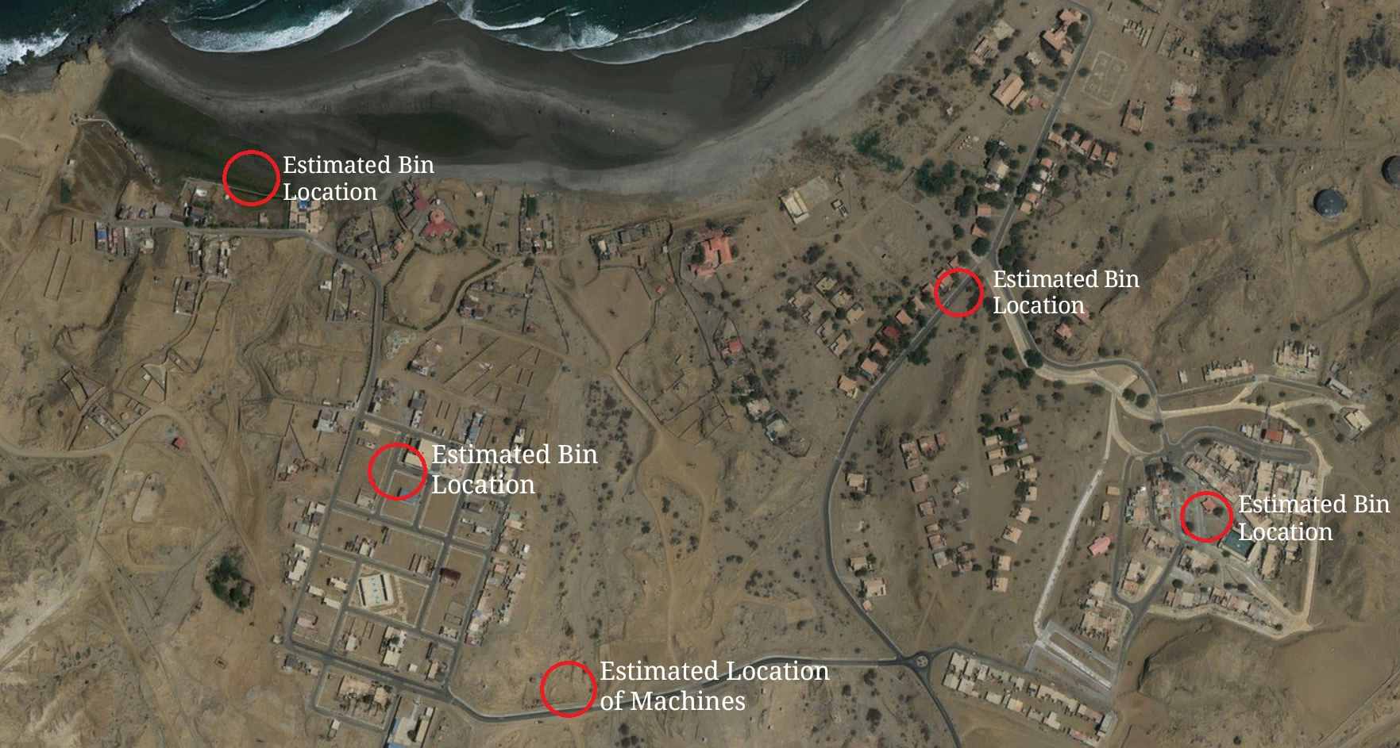

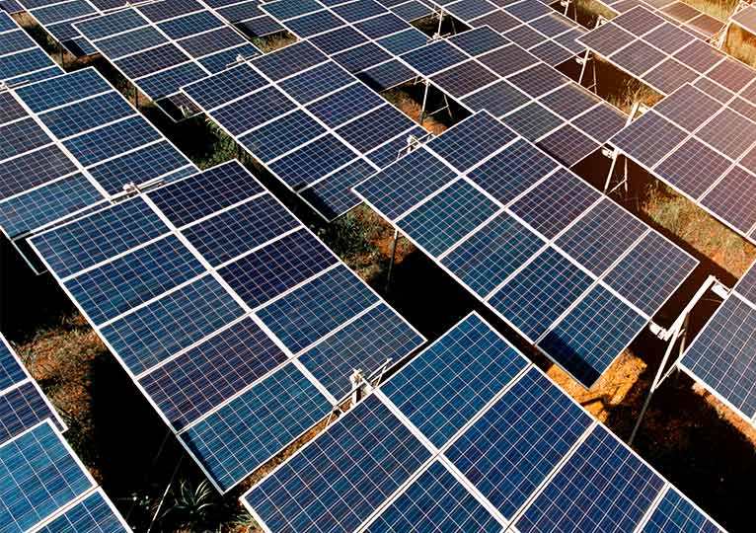
Plastics
Sustainable Plastic Recycling
9. Risk and Safety
i
o
For Peru
8. Sustainability
e
b
Group 27
Ross Brown Cameron Maxwell Andrew Leahy
Callum Jardine Chi Hang Tse Zeon Ojouko
d
i
By Plastics For Peru
r
t
i
o
t
s
a
s
1. About Us
5. Processes
Despite good amounts of tourism in the area the communities of Lobitos and Piedritas struggle from high levels of poverty. This is partly because much of the money generated from this tourism goes to foreign investors instead.
In order to improve the quality of life of people in the region we plan to recycle their plastic waste into several solutions which can be used to help the community and several items which can be sold to tourists, generating capital which can then be reinvested into our project and allowing the local community to benefit more from the tourism industry.
As plastic is so versatile it can be used to address a range of issues the communities faces from rainwater collection to school supplies. Our project also allows new solutions to be created as new issues come up.
Waste is collected from three key areas:
The towns
The local dumpsite
The sea
The plastic can also be Imported from other areas of Peru if the supply was too low from the local area.
It is then taken to a local collection point.
Here, the plastics are inspected and sorted into the various plastic types.
A mobile collection van can also be used to take the plastic to the recycling centre.
Distanced
Entanglement
Maintenance
Sharp objects
Toxic fumes
10. Map of Lobitos Locations
The recycled plastics will be used to make various items, such as:
face masks
key chains
rulers
The plastics are then received from the collection point.
They are processed into a form where they can be reused.
2. Design Matrix
6. Machines
Generating items from waste plastic involves 3 steps.
Shredding of the plastic into smaller parts.
Melting the shredded plastic.
Pumping the melted plastic into a mould and letting it set.
The Shredder
11. Economics
The 3 Machines
The Shredder – Breaks larger plastic objects down into small parts, easier and more consistent to melt
The Injection Moulder – Both melts the plastic and moulds it, producing more intricate 3D items.
The Extrusion Moulder – Melts the plastic and moulds to produce a beam of specified shape, can be 2D, or 3D.
3. SWOT Analysis
The Injection Moulder
The Extrusion Moulder
7. Energy
A 25kV Hybrid Solar System was chosen based one energy requirements
Peru receives consistent high-intensity sun that provides a valuable source of energy
Hybrid solar system to ensure a constant supply of energy
Costs | GBP | Sol
Solar Panels | £19,810.97 | S/ 94,819.09
Fencing | £5,744.15 | S/ 27,492.60
Salaries | £12,102.24 | S/ 57,508.86
Machines | £4,333.22 | S/ 20,739.62
Molds (stage 1 - 3) | £3,389.82 | S/ 16,224.33
Collection Points | £1,439.65 | S/ 6,890.44
Shipping (estimate) | £10,000.00 | S/ 47,519.19
Total | £56,820.05 | S/ 271,194.13
4. Long Term Plan
Stage 0
- Source Funding for the project
Assemble and ship the required goods
Acquire land and develop the facility
Begin a training scheme for unemployed locals
Stage 1
Place Recycling collection points & collect all available recycled plastics
Begin production on face shields & classroom supplies
Distribute items amongst Lobitos & Piedritas
Measure success at this stage, can we progress?
Stage 2
Diversify our production, making water bottles, keyrings and recycling bins.
Sell keyrings to tourists, recycling all money earned back into production.
Stage 3, 4 and 5
Through measuring the success of the previous stage, upscale production in order to make both, more, and larger items.
Increase the amount of machinery and solar panels in order to sustain a healthy manufacturing process.

Slide 6
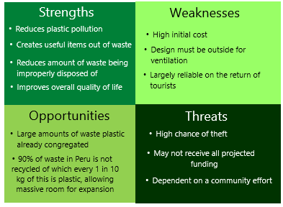
Plastics
Sustainable Plastic Recycling
8. Sustainability
i
o
For Peru
9. Risk and Safety
e
b
d
i
Group 27
Ross Brown Cameron Maxwell Andrew Leahy
Callum Jardine Chi Hang Tse Zeon Ojouko
By Plastics For Peru
r
t
i
o
t
s
a
s
1. About Us
5. Processes
Despite good amounts of tourism in the area the communities of Lobitos and Piedritas struggle from high levels of poverty. This is partly because much of the money generated from this tourism goes to foreign investors instead.
In order to improve the quality of life of people in the region we plan to recycle their plastic waste into several solutions which can be used to help the community and several items which can be sold to tourists, generating capital which can then be reinvested into our project and allowing the local community to benefit more from the tourism industry.
As plastic is so versatile it can be used to address a range of issues the communities faces from rainwater collection to school supplies. Our project also allows new solutions to be created as new issues come up.
Waste is collected from three key areas:
The towns
The local dumpsite
The sea
The plastic can also be Imported from other areas of Peru if the supply was too low from the local area.
It is then taken to a local collection point.
Here, the plastics are inspected and sorted into the various plastic types.
A mobile collection van can also be used to take the plastic to the recycling centre.
Distanced
Entanglement
Maintenance
Sharp objects
Toxic fumes
10. Map of Lobitos Locations
The recycled plastics will be used to make various items, such as:
face masks
key chains
rulers
The plastics are then received from the collection point.
They are processed into a form where they can be reused.
2. Design Matrix
6. Machines
Generating items from waste plastic involves 3 steps.
Shredding of the plastic into smaller parts.
Melting the shredded plastic.
Pumping the melted plastic into a mould and letting it set.
The Shredder
11. Economics
The 3 Machines
The Shredder – Breaks larger plastic objects down into small parts, easier and more consistent to melt
The Injection Moulder – Both melts the plastic and moulds it, producing more intricate 3D items.
The Extrusion Moulder – Melts the plastic and moulds to produce a beam of specified shape, can be 2D, or 3D.
3. SWOT Analysis
The Injection Moulder
The Extrusion Moulder
7. Energy
A 25kV Hybrid Solar System was chosen based one energy requirements
Peru receives consistent high-intensity sun that provides a valuable source of energy
Hybrid solar system to ensure a constant supply of energy
Costs | GBP | Sol
Solar Panels | £19,810.97 | S/ 94,819.09
Fencing | £5,744.15 | S/ 27,492.60
Salaries | £12,102.24 | S/ 57,508.86
Machines | £4,333.22 | S/ 20,739.62
Molds (stage 1 - 3) | £3,389.82 | S/ 16,224.33
Collection Points | £1,439.65 | S/ 6,890.44
Shipping (estimate) | £10,000.00 | S/ 47,519.19
Total | £56,820.05 | S/ 271,194.13
4. Long Term Plan
Stage 0
- Source Funding for the project
Assemble and ship the required goods
Acquire land and develop the facility
Begin a training scheme for unemployed locals
Stage 1
Place Recycling collection points & collect all available recycled plastics
Begin production on face shields & classroom supplies
Distribute items amongst Lobitos & Piedritas
Measure success at this stage, can we progress?
Stage 2
Diversify our production, making water bottles, keyrings and recycling bins.
Sell keyrings to tourists, recycling all money earned back into production.
Stage 3, 4 and 5
Through measuring the success of the previous stage, upscale production in order to make both, more, and larger items.
Increase the amount of machinery and solar panels in order to sustain a healthy manufacturing process.

